Slide 1
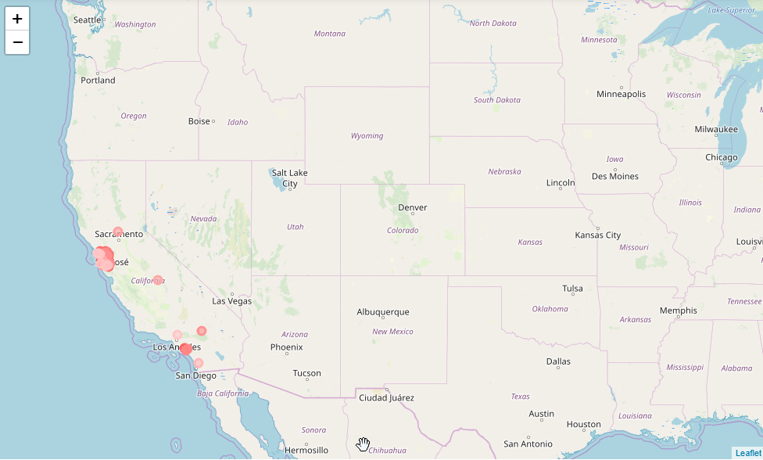
Date a Scientist
Code Academy Machine Learning Capstone
Anthony Graves
1/6/19

Slide 2
Table of Contents
1. Does income play a role in how a dating profile is viewed by the opposite sex?
2. Geolocation columns classify and pinpoint where the dating profiles are located
3. Pairwise Plot data visualization
4. Correlation matrix between quantifiable features of the dataset
5. Distribution of reported and non-reported income
6. Logistic Regression, Precision, Accuracy, ROC Curve, Logit Regression results, P-values and K-nearest values
7. Conclusion
8.Next steps

Slide 3
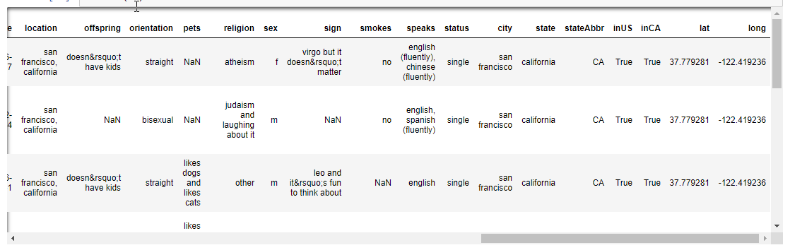
Geolocation Data Columns: Longitude and Latitude

Slide 4
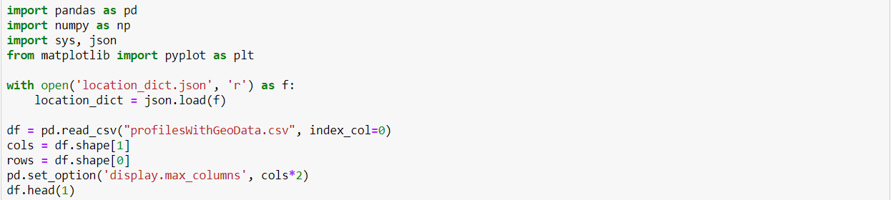
How I added columns to the profileswithGeodata.csv
Using Json library:
us_states.json
Location__dict.json
This enhancement helped to show that the data was based on dating profiles from mostly the city’s of San Francisco(Bay Area) and Los Angeles of California.

Slide 5
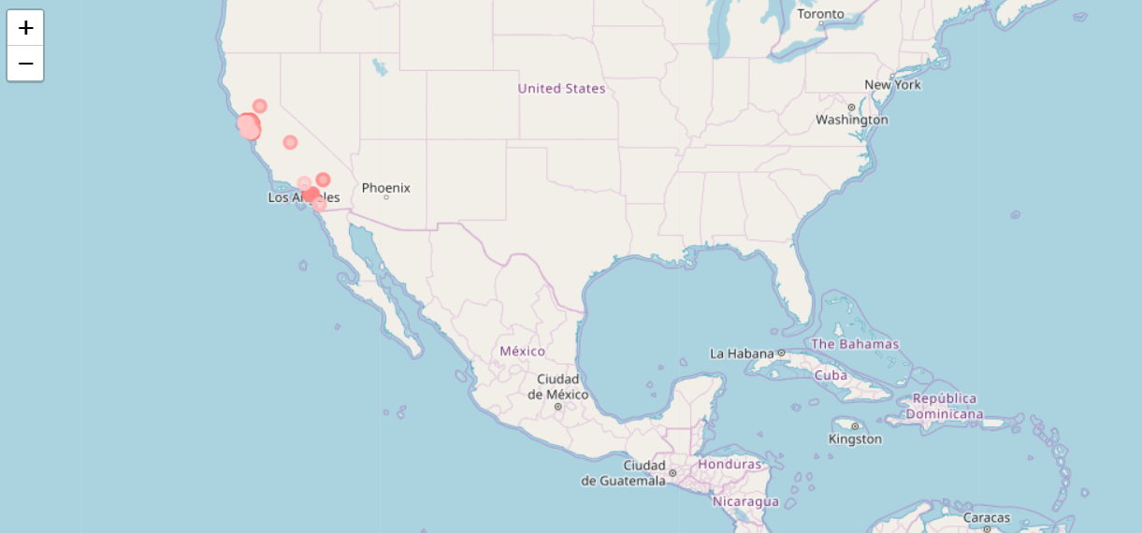
Geographical location of dating Profiles in CA

Slide 6
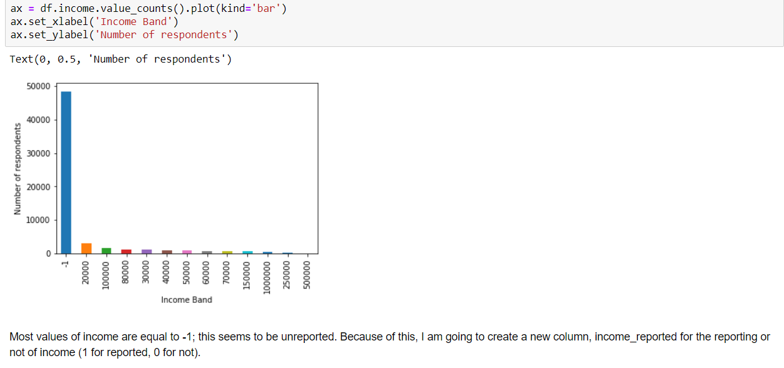
Reported Income

Slide 7
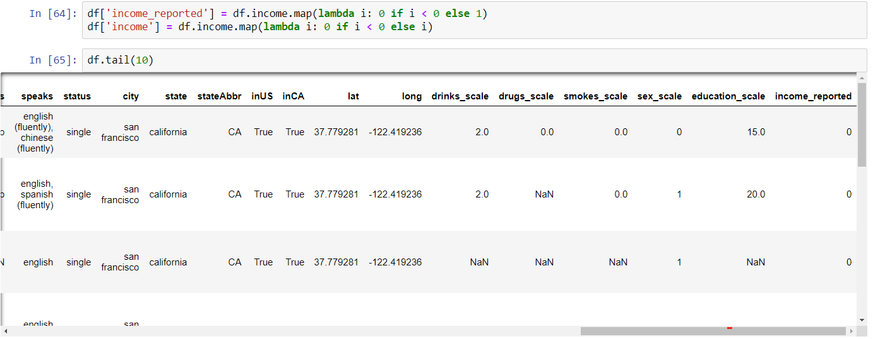
Weighted Income Reported Table

Slide 8
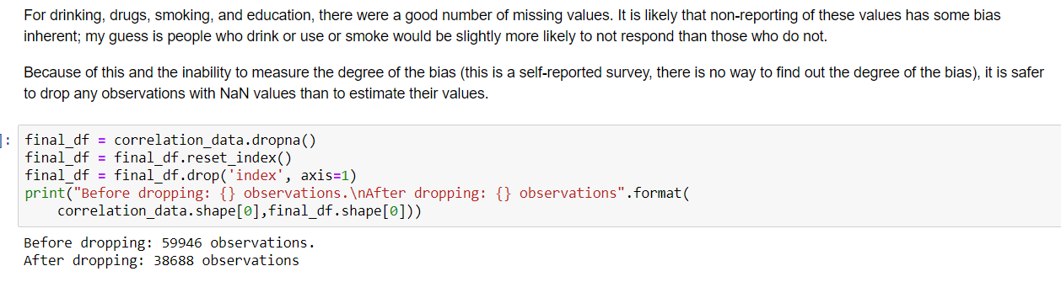
Dealing with NaN Values

Slide 9
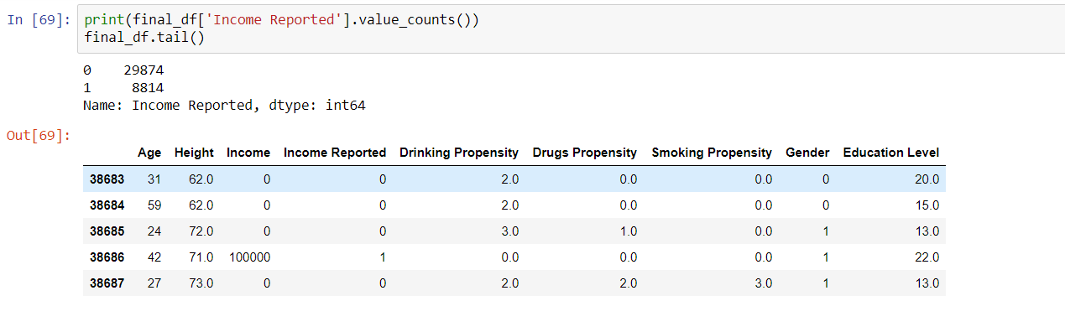
Income Reported

Slide 10
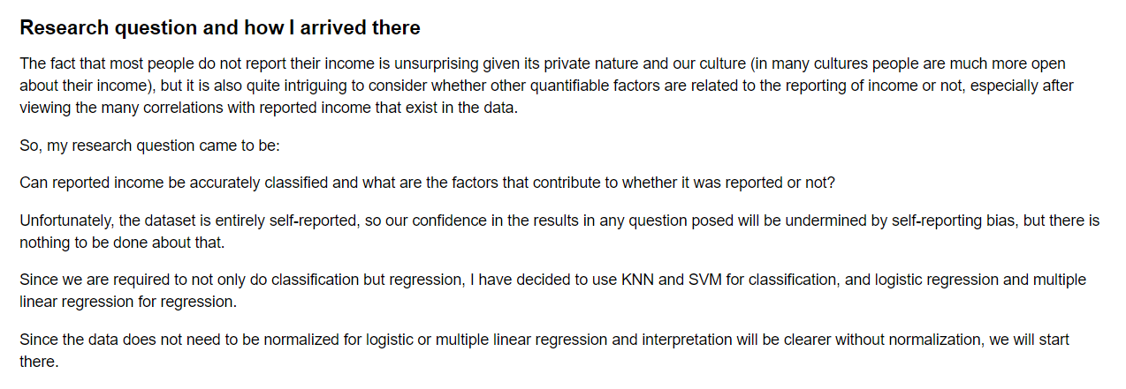
Research Question

Slide 11
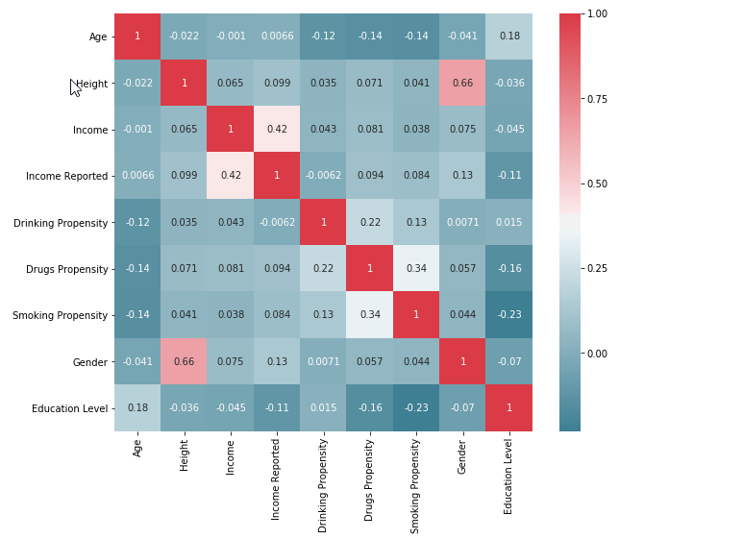
Correlation matrix between quantifiable features of the dataset

Slide 12
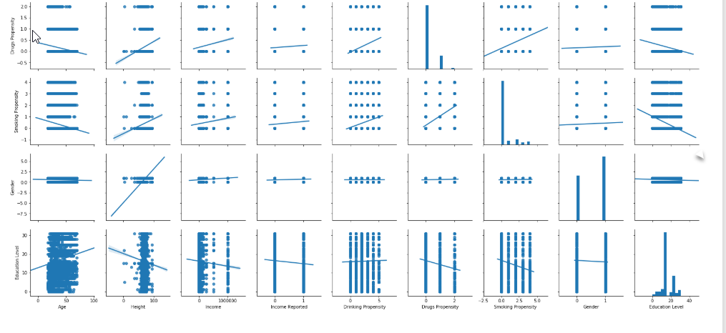
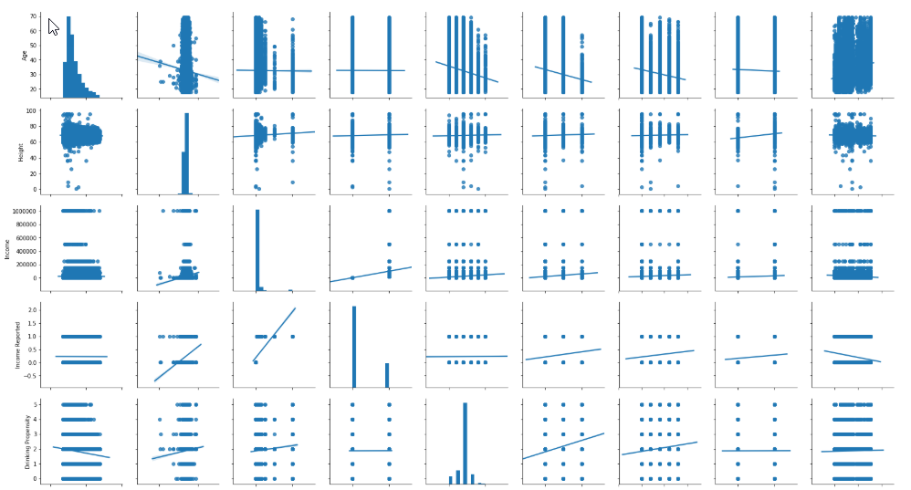
Pairwise Plot Data Visualization
Pair Plot 1 showing mostly positive correlations
Pair Plot 2 showing some neutral, positive and negative correlations

Slide 13
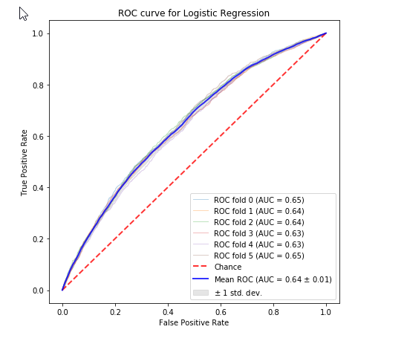
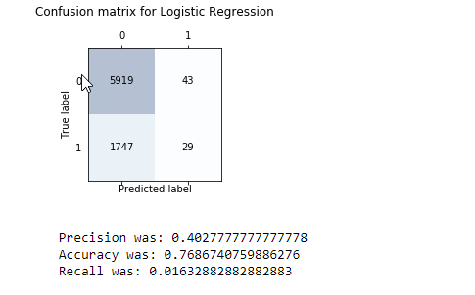
Logistic Regression, Precision, Accuracy, ROC Curve, Logit Regression results, P-values and K-nearest values
A. Confusion Matrix for Logistic Regression B. ROC Curce for Logistic Regression

Slide 14
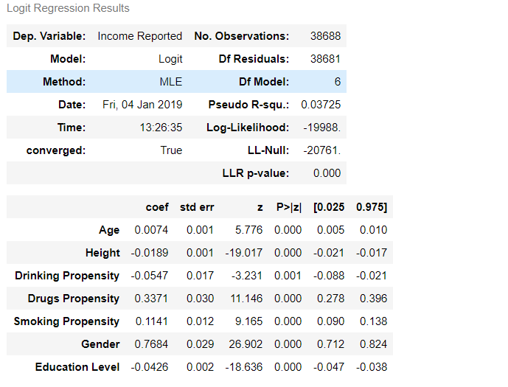
Logistic Regression, Precision, Accuracy, ROC Curve, Logit Regression results, P-values and K-nearest values
C. Logit Regression Results

Slide 15
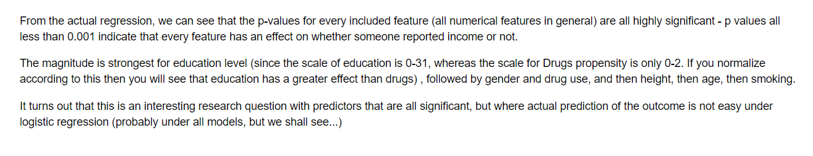
Logit Regression Model Interpretation

Slide 16
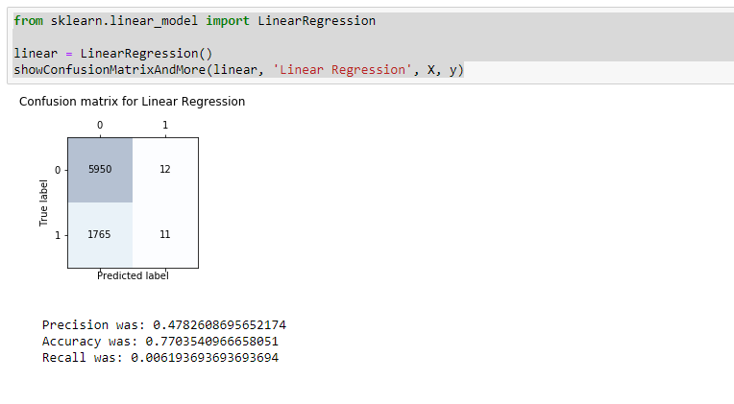
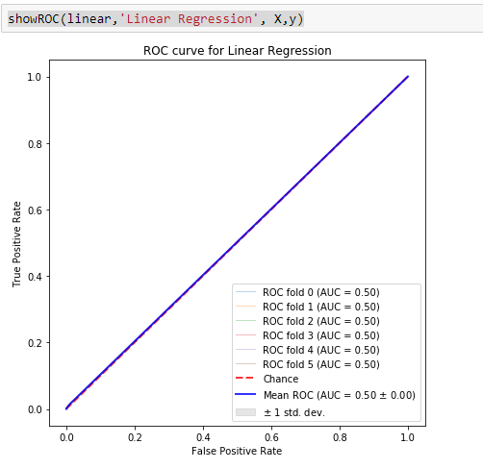
Logistic Regression, Precision, Accuracy, ROC Curve, Logit Regression results, P-values and K-nearest values
D. Confusion Matrix for Linear Regression E.ROC Curve for Linear Regression

Slide 17
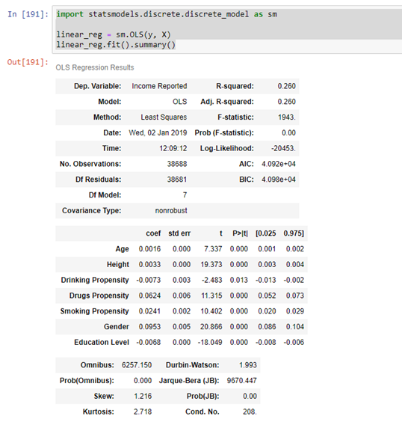
OLS Regression Results

Slide 18
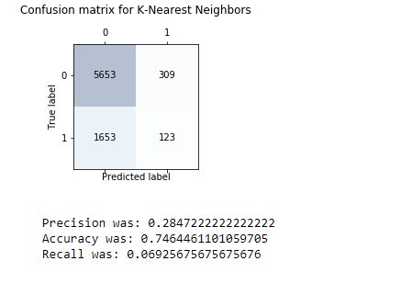
K –Nearest Neighbors
Precision is down from the regression models, but the amount of positive predictions is higher, so the models cannot be compared.

Slide 19
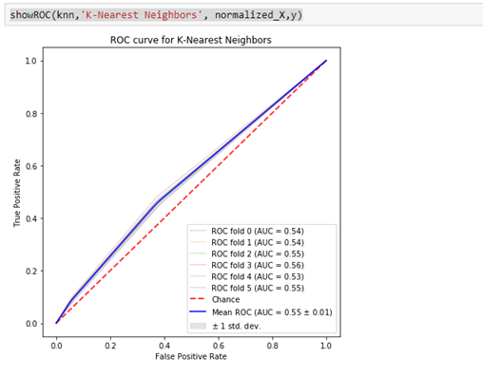
K – Nearest Neighbors does have some predictive power, but it seems like logistic regression is in the lead.

Slide 20
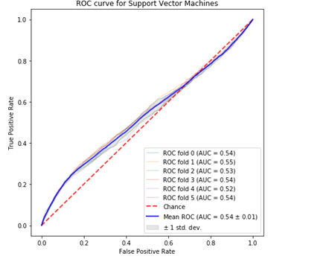
ROC Curve for Support Vector Machines
SVM is the most complex to run on this data. It also takes by far the most time to run( about an hour for a dataset that is small (less than 40,000 observations of reported income.
However it was still beaten by both logistic regression and k –nearest neighbors.

Slide 21
Conclusion
Analysis
Further research
The regressions performed clearly show that the numerical features of the dataset all help predict whether someone will report their own income or not, in the following order of importance (the direction, + meaning more likely to report and – meaning less likely, is in parenthesis
Education (-)
Drug use(+)
Gender (+-> males)
Height (-)
Age (+)
Smoking (+)
The actual classification part of the problem did not go as well. The ROC curves, especially of logistic regression, show that there is some predictive power to the models (outside of linear regression), but it probably is not strong enough for practical use.
In depth text analysis of the essays of dating profiles could be done; this could be transformed into a proxy for writing skill which might not perfectly correlate with education level. This might give more predictive power to the model.

Slide 22

THANK YOU
Anthony Graves

